Slide 1
Online Arabic Handwriting Recognition
By George Kour
Supervised by Dr. Raid Saabne

Slide 2
Machine Learning (Optional)
Main model (PAC)

Slide 3
Pattern Recognition(Optional)
Supervised learning vs. unsupervised learning
Classification techniques
Binary classification vs. multiclass classification
Naïve Bayes
Neural Network
Tree
Clustering
Supervised techniques
SVM
K- means

Slide 4
Background
Feature
Metrics
Dimensionality Reduction
Classification

Slide 5
The Arabic Letters
Arabic is the Mother tongue of more than 350 Million people.
Other languages that use the Arabic letters is parsian ...
How many manuscripts arte written in Arabic
Arabic is a cursive language
It is composed by word parts.
Show samples of Arabic script.

Slide 6
Support Vector Machines
Given Training sample data of the form:
Find the maximum margin hyperplabe that divides samples of the two classes.
The hyperplane formula:
If the samples are linearly separable, there may be infinite hyperplanes separating the samples of the two classes. Which is the best?
x₂
x₁
denotes +1
denotes -1

Slide 7
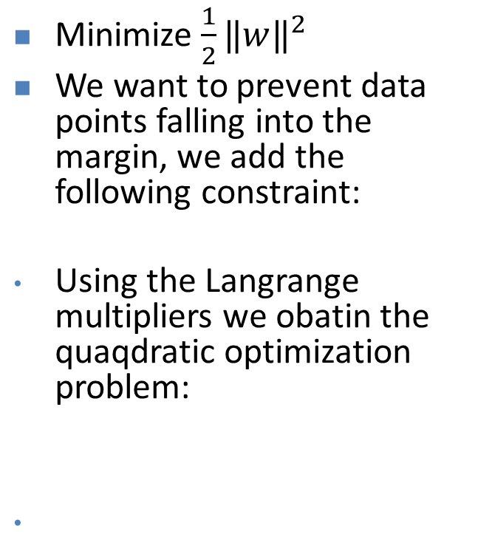
Support Vector Machines
x₂
Minimize ${\frac{1}{2}‖w‖}^{2}$
We want to prevent data points falling into the margin, we add the following constraint:
Using the Langrange multipliers we obatin the quaqdratic optimization problem:
Margin
x⁺
w^{T} x + b = 1
x⁺
w^{T} x + b = 0
w^{T} x + b = -1
n
x⁻
Support Vectors
x₁
denotes +1
denotes -1

Slide 8
Non Linear SVM
Datasets that are linearly separable with noise work out great:
0
x
But what are we going to do if the dataset is just too hard?
0
x
How about… mapping data to a higher-dimensional space:
x²
0
x

Slide 9
Nonlinear SVMs: The Kernel Trick
With this mapping, our discriminant function is now:
No need to know this mapping explicitly, because we only use the dot product of feature vectors in both the training and test.
A kernel function is defined as a function that corresponds to a dot product of two feature vectors in some expanded feature space that satisfies the Mercer’s Condition:

Slide 10
Nonlinear SVMs: The Kernel Trick
An example:
2-dimensional vectors x=[x₁ x₂];
let K(x_{i},x_{j})=(1 + x_{i}^{T}x_{j})²,
Need to show that K(x_{i},x_{j}) = φ(x_{i}) ^{T}φ(x_{j}):
K(x_{i},x_{j})=(1 + x_{i}^{T}x_{j})²,
= 1+ x_{i1}²x_{j1}² + 2 x_{i1}x_{j1} x_{i2}x_{j2}+ x_{i2}²x_{j2}² + 2x_{i1}x_{j1} + 2x_{i2}x_{j2}
= [1 x_{i1}² √2 x_{i1}x_{i2} x_{i2}² √2x_{i1} √2x_{i2}]^{T} [1 x_{j1}² √2 x_{j1}x_{j2} x_{j2}² √2x_{j1} √2x_{j2}]
= φ(x_{i}) ^{T}φ(x_{j}), where φ(x) = [1 x₁² √2 x₁x₂ x₂² √2x₁ √2x₂]
This slide is courtesy of www.iro.umontreal.ca/~pift6080/documents/papers/svm_tutorial.ppt

Slide 11
Nonlinear SVMs: The Kernel Trick
Examples of commonly-used kernel functions:
Linear kernel:
Polynomial kernel:
Gaussian (Radial-Basis Function (RBF) ) kernel:
Sigmoid:
In general, functions that satisfy Mercer’s condition can be kernel functions.

Slide 12
Sequence Metric - DTW
Measuring sequences differences
The Idea
Implementation
Examples
Fast and restricted DTW
Does not comply to the triangle inequality.
Complexity analysis

Slide 13
Sequence Metric - EMD
The same analysis as DTW
The embedding.

Slide 14
Feature
Sequence
Shape Context
MAD

Slide 15
Samples Collection and Storing
Online User Input system
Each User draws all the letters in all possible position (Ini, Mid, Fin, Iso).
Letter Sequences are saved as .m files in the File System
File System Structure
Letters Samples
A
Iso
Sample1 (.m file)
Sample2 (.m file)
Fin
Sample1 (.m file)
Sample2 (.m file)
B
Ini
Sample1 (.m file)
Sample2 (.m file)
Mid
Fin
Iso
…

Slide 16
Samples Collection and Storing (Cont.)
From ADAB Database.
ADAB contains sequences of online data of Tunisian cities.
We build a system that segments the words in ADAB to output letters samples.

Slide 17
Word Parts Generation
Word Part is Arabic Sub word that are written in a single stroke
We built a system that generates sequences of all possible Arabic Word Parts.
The Word parts are generated using

Slide 18
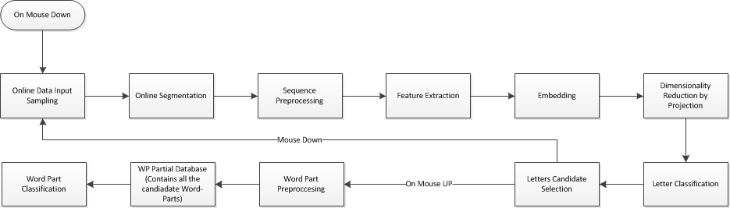
Online Arabic Recognition

Slide 19
Online Segmentation
Choosing candidates points in the writing process and then selecting the right combinations of demarcation points using dynamic programming.
How to select the candidate points:
SVM
There could be several segmentation options.
Then select for each segmentation the candidate letters and then holistically select the word part.
Important properties:
Min Over Segmentation
No Under Segmentation(*) – Complex Letters
Improvements:
How to use simplification to better perform the segmentation points?

Slide 20
Online Segmentation Introduction
Definitions:
Candidate point
Critical point
Segmentation point
Learning Technique
Features
Slope
Forward direction
Classification technique
Find points that are classified

Slide 21
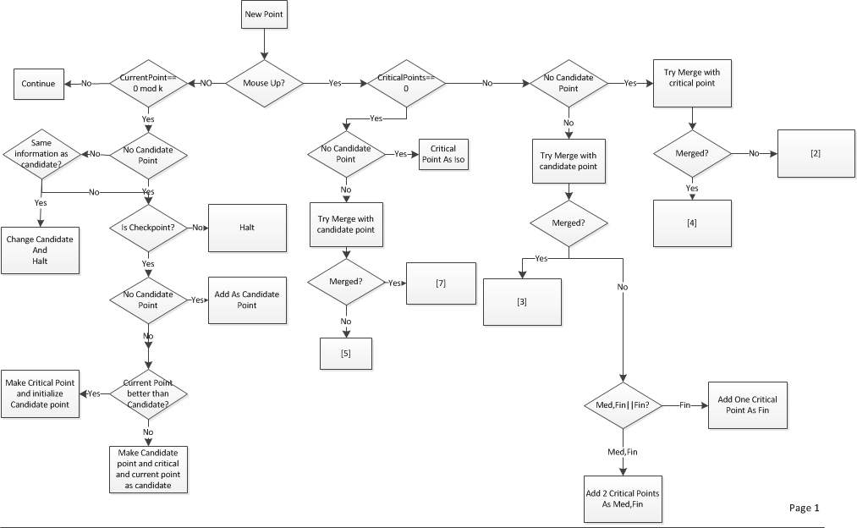
Online Segmentation

Slide 22
Letter Samples Processing
Normalization
Line Simplification
Using Recursive Douglas-Peucker Polyline Simplification
Resampling

Slide 23
Feature Extraction

Slide 24
Embedding

Slide 25
Dimensionality Reduction

